Slide 1
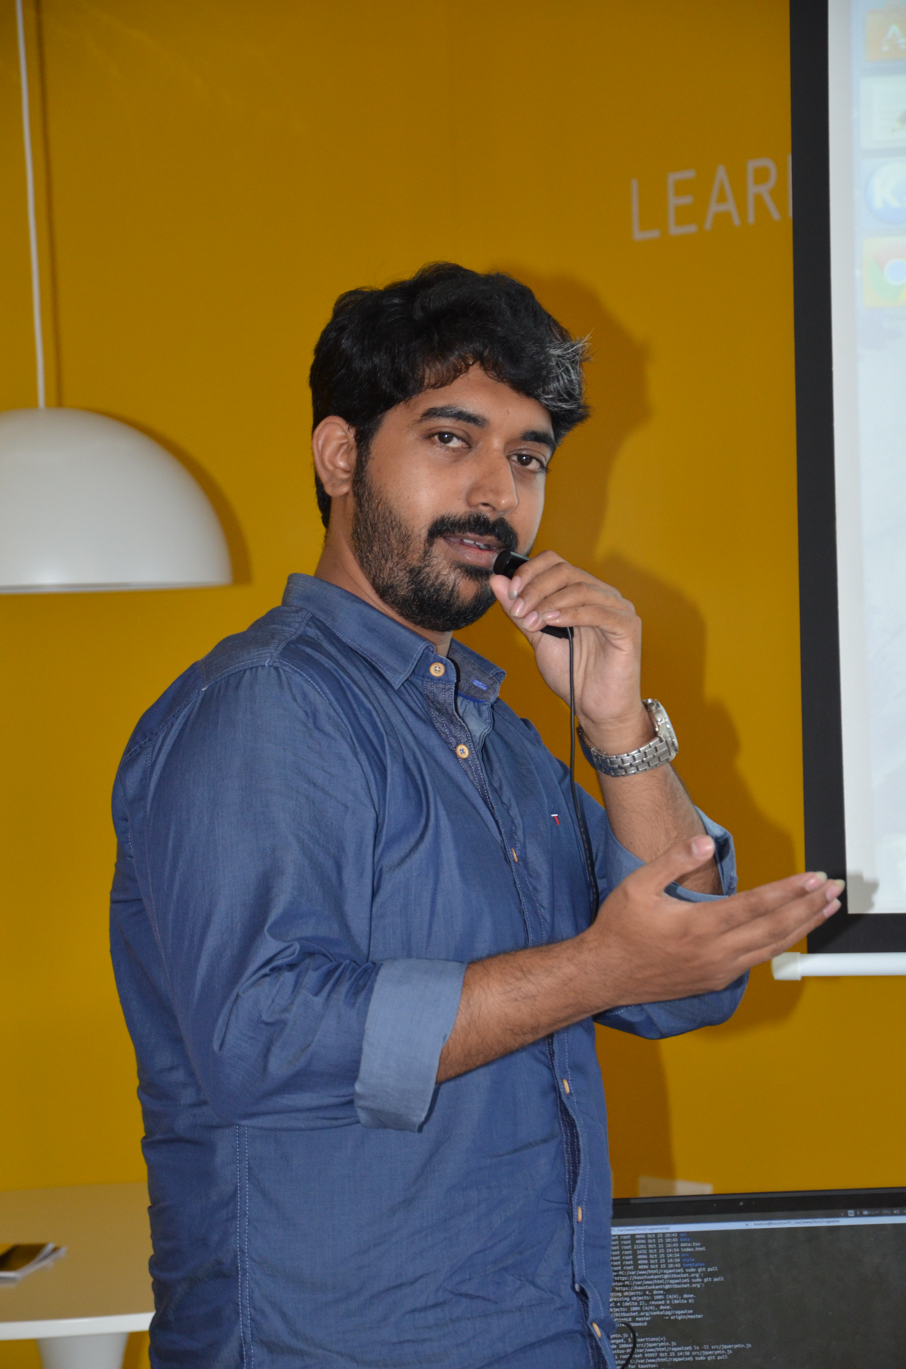
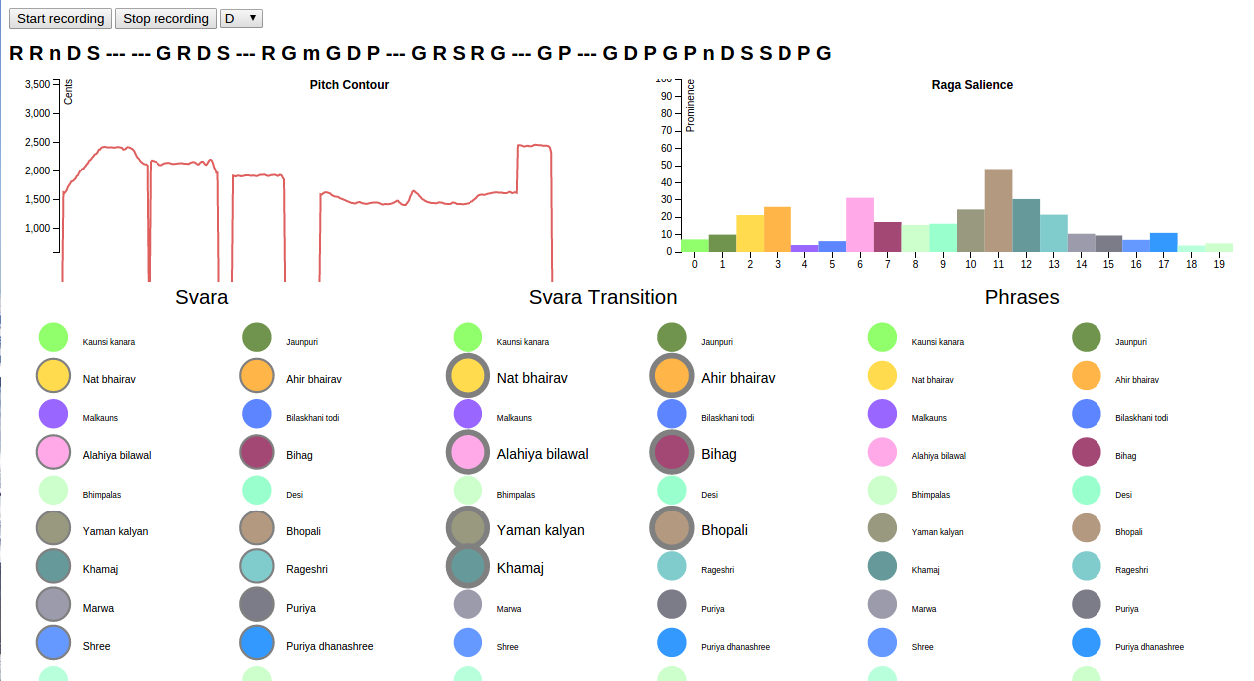
Rāgawise: real-time rāga recognition
Pitch extraction
Melody transcription
Rāga database
Svara (note)
Svara transition
Svara sequence

